Slide 1
Smart device sensors programing
Assistant : Simonas Česnauskas

Slide 2
The purpose of the subject
The main goal is to acquaint with the design of a smart device and the programming of its components.

Slide 3
The structure of the subject
Introduction to electronics. Basic knowledge of electronics and acquaintance with components;
Programming of data entry components;
Programming of data output components.

Slide 4
Lab works
In total we will have 10 practical lectures;
8 planned laboratory works;
2 laboratory work defenses;
We will do what we can with distance learning;
We will do as much as we can.

Slide 5
Settlements
We will have 2 colloquia;
We will have 2 laboratory work defenses;
We will have a final report, an exam.

Slide 6
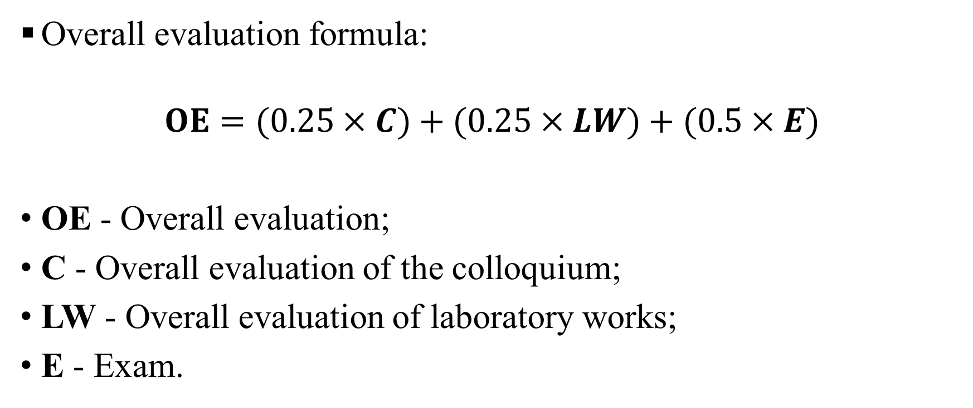
Overall evaluation
Overall evaluation formula:
$$OE=(0.25×C)+(0.25×LW)+(0.5×E)$$
OE - Overall evaluation;
C - Overall evaluation of the colloquium;
LW - Overall evaluation of laboratory works;
E - Exam.

Slide 7
Goodbye

Slide 9
Smart devices sensors programming
Assistant : Simonas Česnauskas

Slide 10

Overview of electronic components
What is electronics?

Slide 11
What is electronics?
Electronics is the science of controlling the flow of electrons. It involves circuits that are made up of parts called components, and connecting wires / conductors that control the flow of electricity and direct it to do useful things or turn them into electrical current and voltage signals to store information.

Slide 12
Resistors, their types and encodings

Slide 13
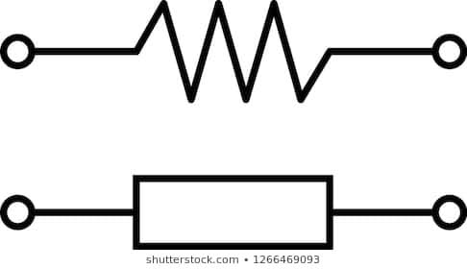
Resistor
It is a device of a certain resistance used to generate the required voltage. It resists the electric current flowing through it, creating a voltage drop between the contacts (because there is no longer enough current to carry the voltage). It releases the voltage that falls on the resistor to the environment in the form of heat. This relationship is described in Ohm's law.

Slide 14
Resistors types
Carbon composition resistors;
Metal / carbon film resistors;
Wire wound resistors;
Variable resistors;
Potentiometers;
Light dependent resistor / photoresistor;
SMD resistors;
Varistors;
Thermistors;

Slide 15
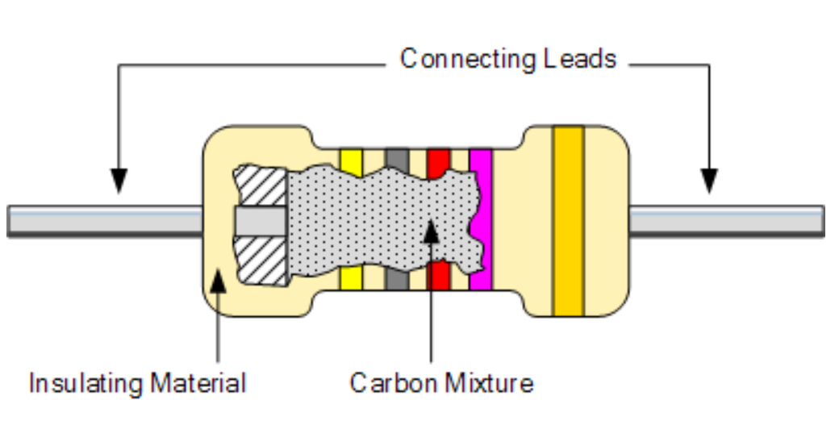
Carbon composition resistors
Because the manufacture of these resistors is relatively inexpensive and simple, they are quite common. However, due to its composition, distortions and noise may occur at high temperatures. Therefore, they are most commonly used in schemes that want cheapness rather than quality performance.
They can be found from 1 (Ohm) to 22 mega (ohms);
They can be found from 0,250w up to 5w.

Slide 16
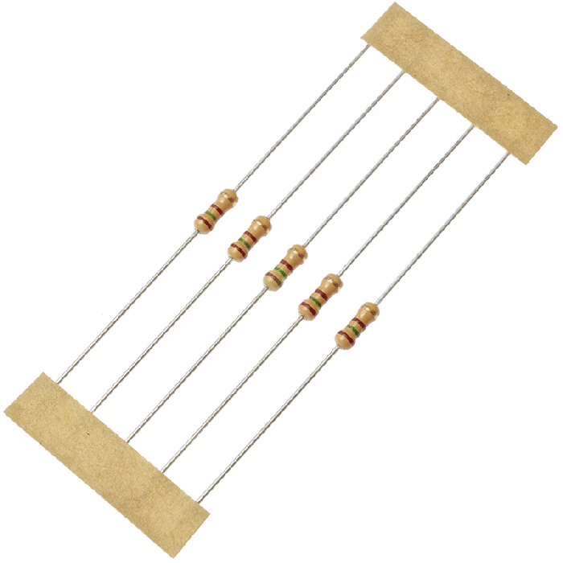
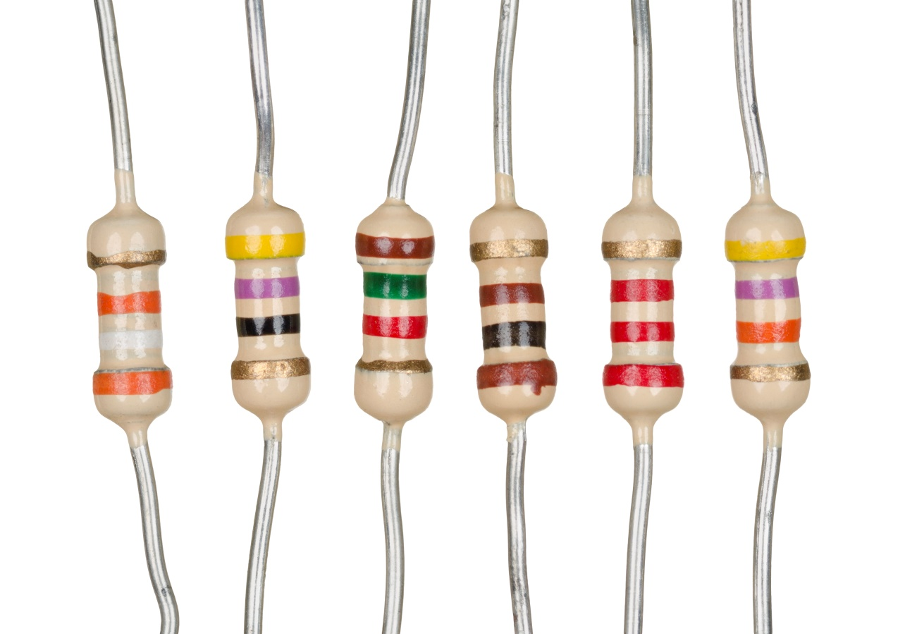
Carbon composition resistors

Slide 17
Metal / carbon film resistors
The composition of these resistors, as the name implies, consists of an impermeable core on which a layer of either carbon or metal particles is deposited in a very thin layer (like a film), which creates the resistance of the component.
The resistance rating is adjusted by controlling the thickness of the layer of particles (film) deposited on the surface.
Or along the component, making a cut in the film, thus reducing the amount of material and at the same time the resistance.
This type of resistor can be found up to a nominal value of 10000Mohm.

Slide 18
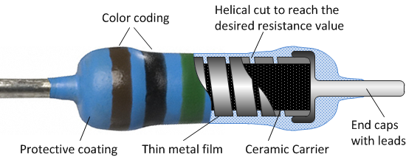
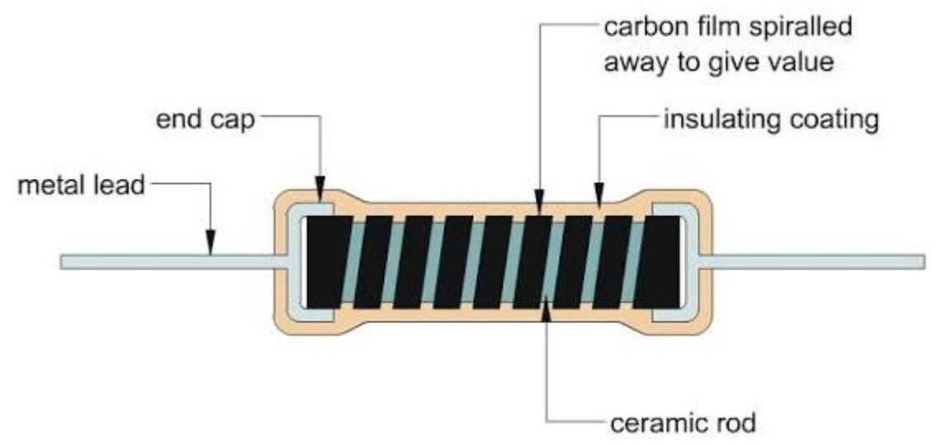
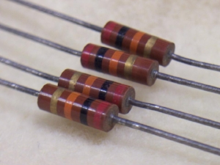
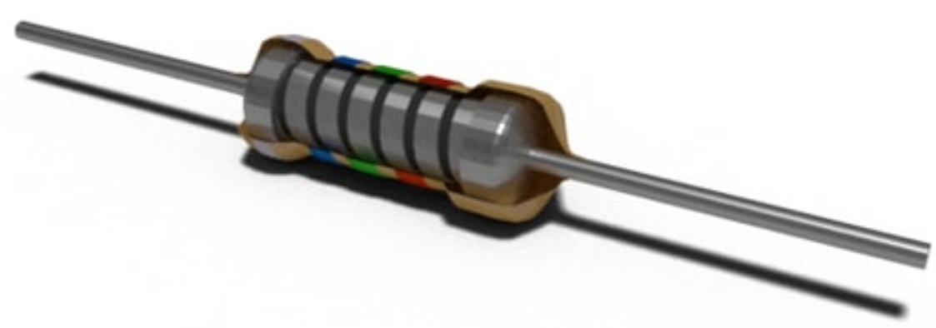
Metal / carbon film resistors

Slide 19
Color codes for 3 to 4 band resistors
The first two bands always indicate the resistance value in ohms;
The third band indicates the multiplier from which we will multiply the resulting resistance value;
The fourth band indicates the tolerance of the resistor;
If a 3-band resistor is used and the fourth band is not available, the tolerance of such resistors shall be ± 20%.

Slide 20
Color codes for 5 to 6 band resistors
These are more accurate resistors because the denomination of the value is indicated by three numbers. So the first three bands indicate the resistance in ohms.
Everything else remains as in the color codes of the 3-4 band resistors. The fourth bar indicates the multiplier.
The fifth bar indicates the tolerance of the component.
The sixth bar can indicate either the reliability rating or the temperature dependence of the resistance.

Slide 21
How to understand color code?
The color code is read from left to right;
Usually the strips on a component are placed closer to one edge than the other. Thus, the edge to which the strips are placed closer is read as the beginning;
Or the strips on one side of the component are stacked more densely. Then this side will be the beginning;
The color code never starts with a metallic color (gold or silver), so if there is such a bar, it will by at the end.

Slide 22
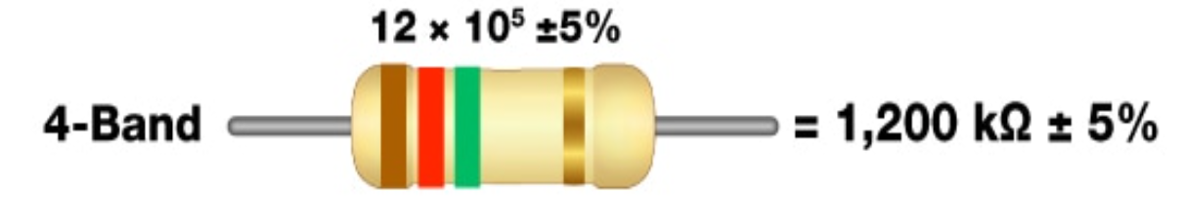
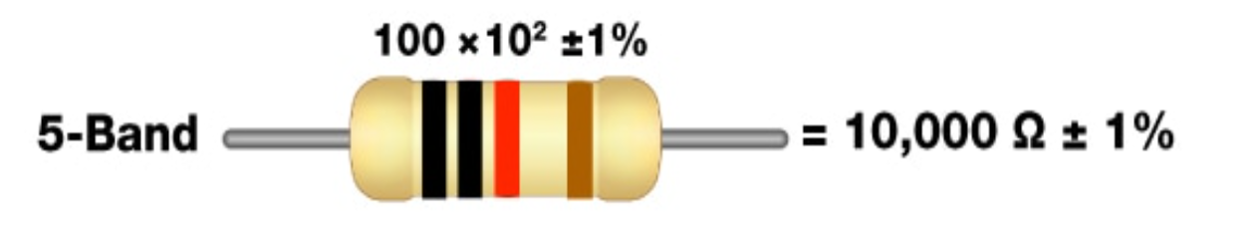
How to understand color code?

Slide 23
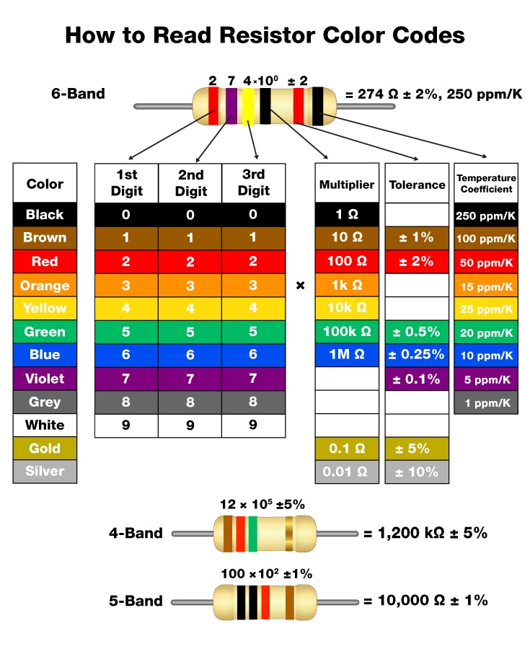
Color code table

Slide 24
An example of understanding color coding
The first and second bands are black, which when viewed in the table corresponds to 0, 0. In this case, we assume that the resistance of the resistor in ohms is 100ohm.
The third band is red, so the multiplier will be 100 or ${10}^{2}$;
Finally, the last, fourth band is brown so according to the table, the component tolerance is ±1%.

Slide 25
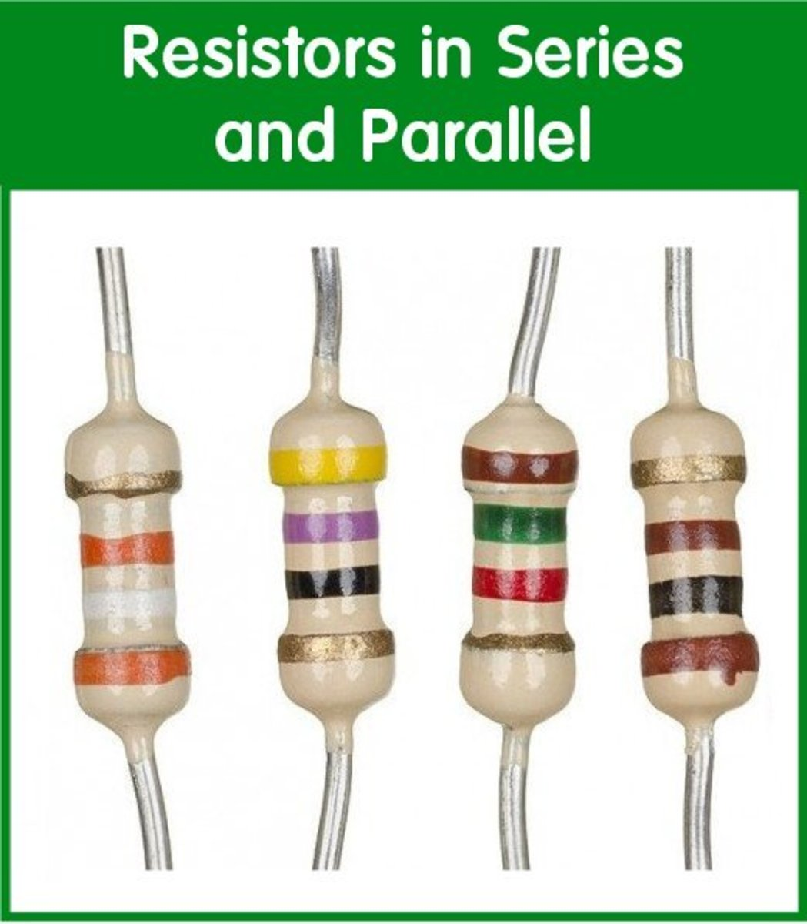

Which resistor is in the correct position?
A
B

Slide 26
What is the resistance of this resistor?
Colors: Brown, red, green, gold.

Slide 27
Resistor resistance

Slide 28
Wire wound resistors
They consist of a metal wire of appropriate resistance wrapped around an impermeable core.
The metal wire is usually either a nickel-chromium alloy or a copper-nickel manganese alloy.
These are the oldest type resistors.
They can withstand large amounts of power (w) and can become very hot during operation. Therefore, newer resistors of this type are housed in aluminum housings to dissipate heat more efficiently.

Slide 29
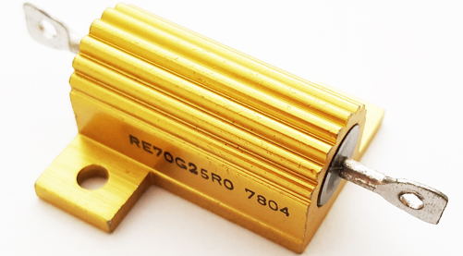
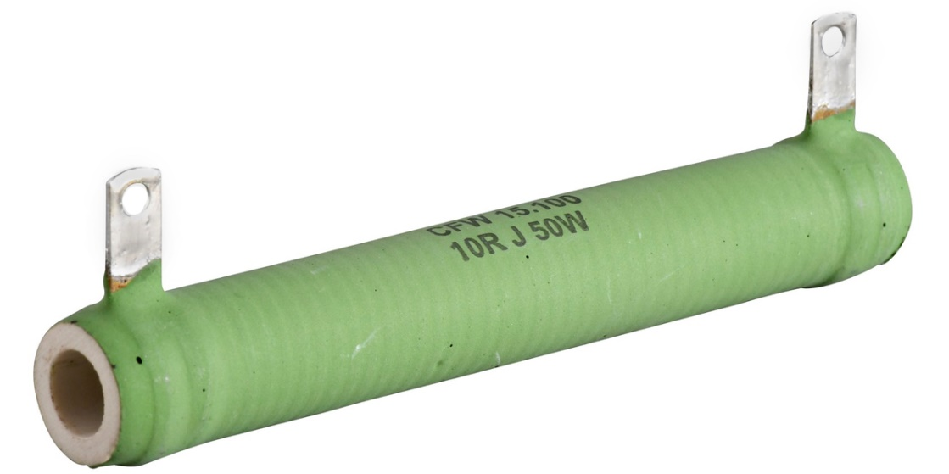
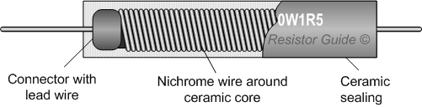
Wire wound resistors

Slide 30
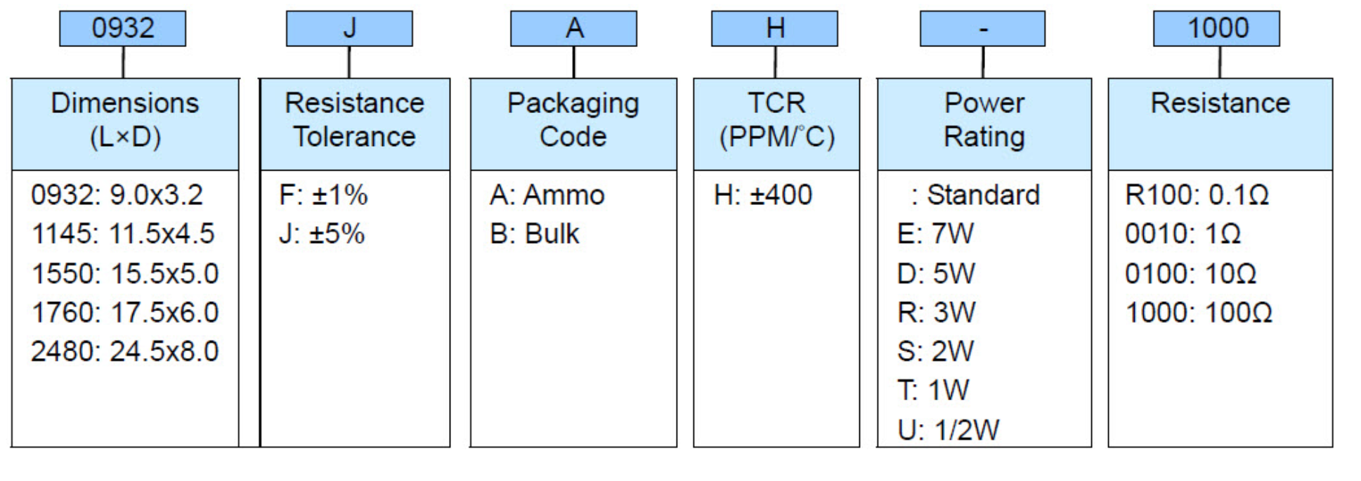
Wire wound resistors
The codes for this type of resistor are usually quite simple and the information is written directly on it because the component itself is quite large.

Slide 31
Example of wire wound resistor code
Code: 10R J 50W
Resistance : 10 omų;
Tolerance : ±5%;
Power : 50 watų.

Slide 32
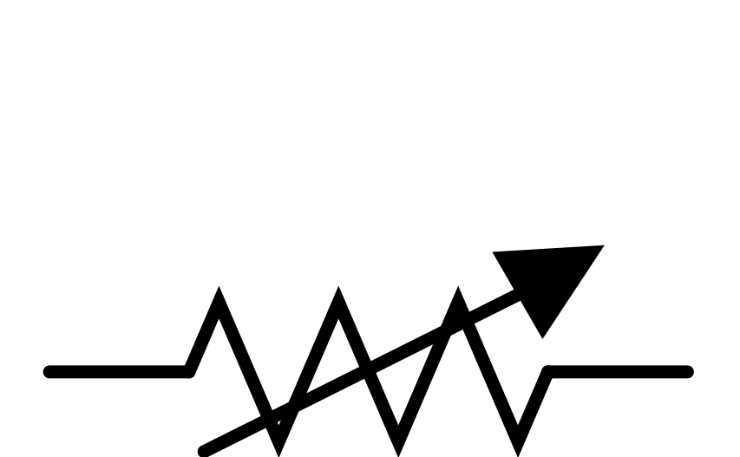
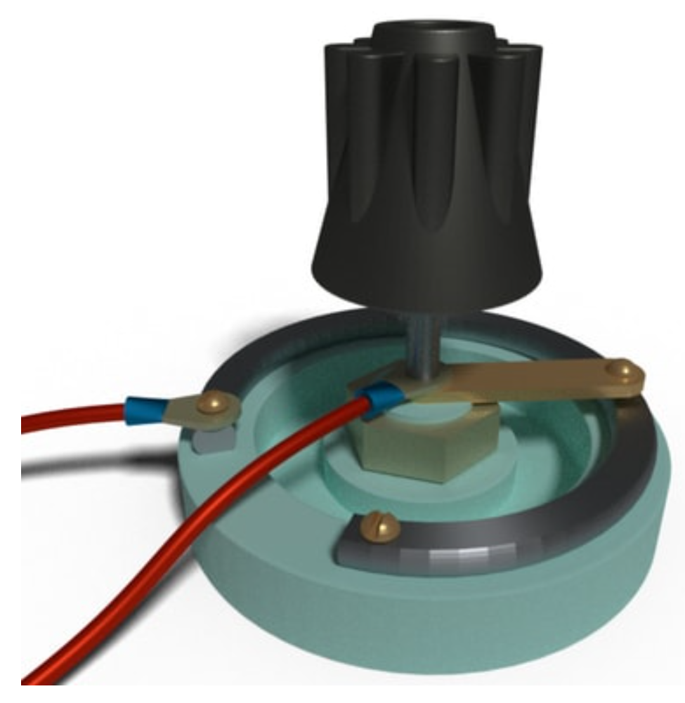
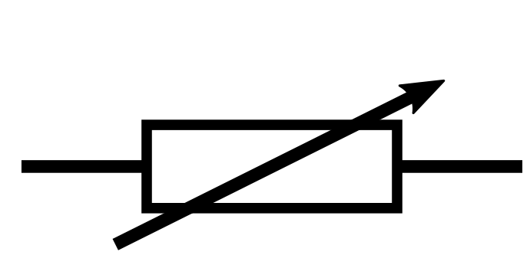
Variable resistors
As the name implies this is an adjustable resistance resistor.
The essence of this type of component is a certain resistive material and contact, which is moved around or along it, thus changing the resistance between the ends of the contacts.

Slide 33
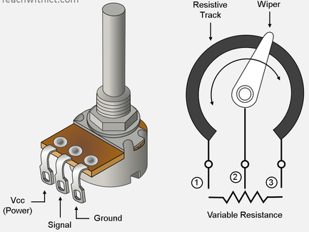
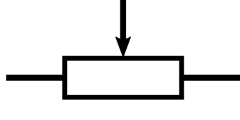
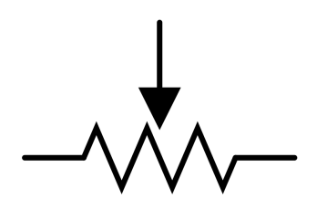
Potentiometers
Iin principle they are very similar to dimmable resistors and can be used as variable resistors if only 2 of the 3 contacts are used.
Unlike adjustable resistors, the resistance of the potentiometer does not really change, the potential changes on the central moving contact, as a result of which this component can be thought of as a voltage divider..

Slide 34
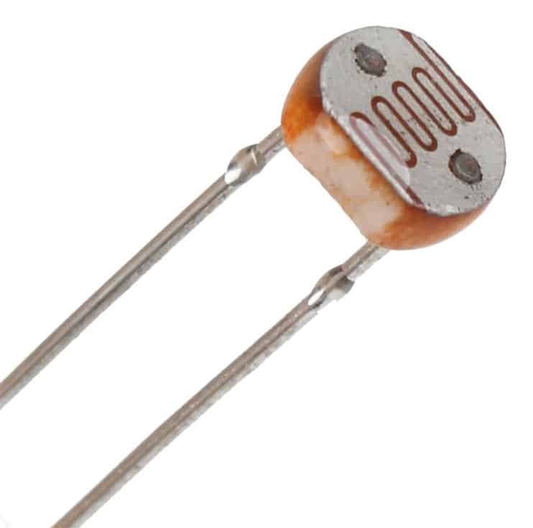
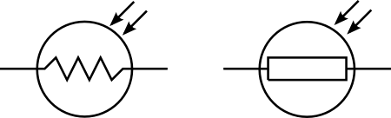
Light dependent resistor / photoresistor
These are components that change their resistance depending on the intensity of the light falling on it.
They usually have a high resistance when in the dark and a significantly lower resistance when in the light.

Slide 35
SMD resistors
To understand what these components are, we need to discuss the methods of component assembly on the printed circuit board. Two component assembly methods are used in the design and implementation of printed circuit boards (PCBs).

Slide 36
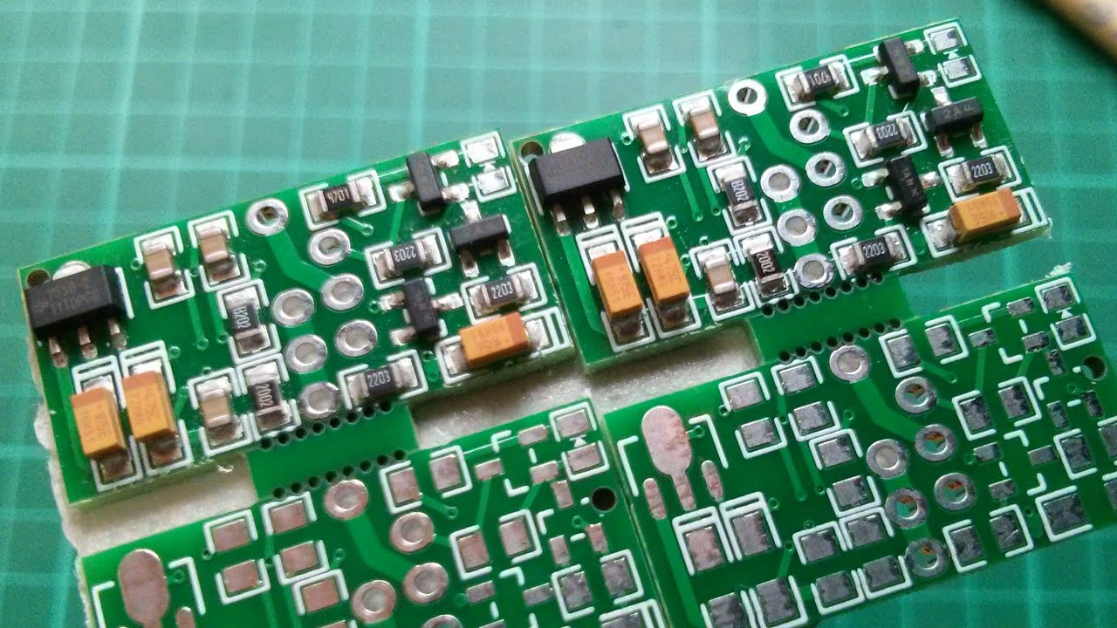
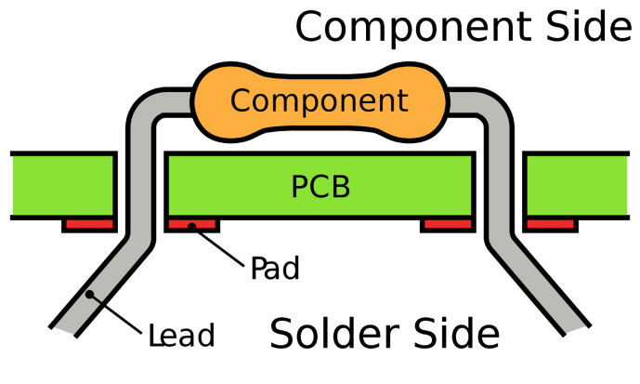
SMD resistors
SMT- Surface mount technology, components that are soldered / mounted on one side of the board (picture on the left).
THT – through hole technology, components are mounted by inserting contacts through a printed circuit board and soldered on the other side (picture on the right).

Slide 37
SMD resistors
Thus, SMD resistors are resistors that are mounted and soldered on one side of the board.
Compared to simple THT resistors, their shape is usually square and they are significantly, significantly smaller than simple resistors.
The size of SMD components is determined by their package. It basically describes the size of the components used in it. The most commonly used SMT package is 0402. The size of the resistor included in this package can be approximately 1mm x 0.5mm.

Slide 38
SMD resistors
Due to the small size of the components, it is no longer possible to use color codes to separate them, so the coding of SMD resistors consists of numbers.
3-digit encoding;
3-digit encoding;
New EIA-96 encoding.

Slide 39
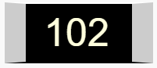
SMD resistor, 3 digit coding
As with color band coding, the first 2 digits indicate the resistor resistance and the third digit indicates the multiplier..
If the resistance of the component is less than 10Ω, the letter R is used.
$$10 × {10}^{2} =1000Ω or 1kΩ$$

Slide 40

SMD resistor, 3 digit coding
3,3Ω

Slide 41

SMD resistor, 4 digit coding
As with the color band code, same here. The resulting additional number allows you to more accurately determine the resistance of the component and everything else shifts to the right.
The first 3 digits indicate the value, and the remaining digits indicate the multiplier.
$$100 × {10}^{2} =10000Ω or 10kΩ$$

Slide 42
SMD resistor, EIA-96 coding
The component is marked with 3 characters.
The first two are always numbers indicating the value of the resistance in the form of 3 numbers.
The last character is a letter indicating a multiplier.

Slide 43
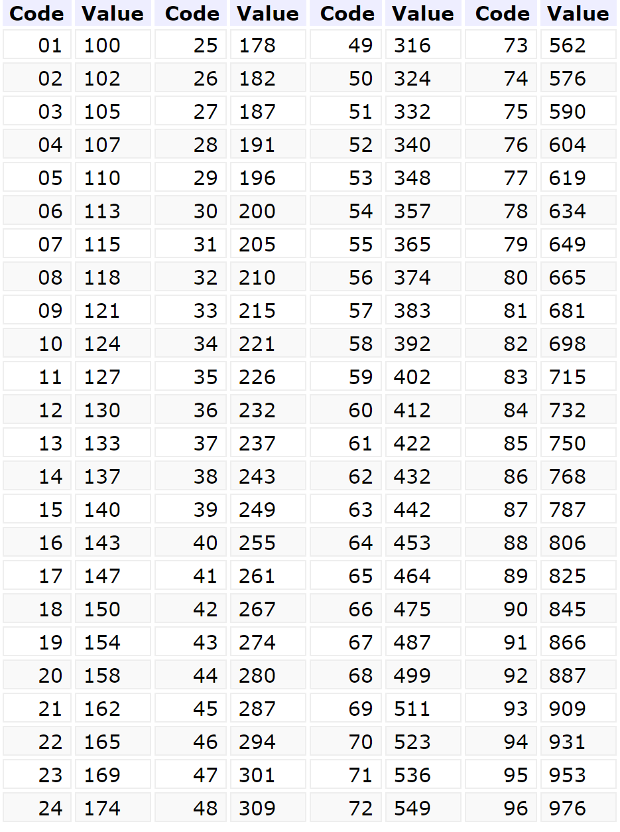
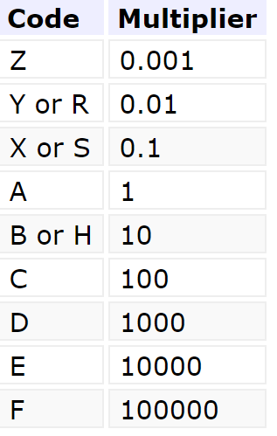

SMD resistor, EIA-96 coding
$$105 × {10}^{1} =1050Ω or 1,05kΩ$$

Slide 44
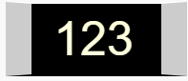
What is the resistance of this SMD resistor?

Slide 45
The resistance of this SMD resistor
$12 × {10}^{3} =12000Ω arba 12kΩ$

Slide 46
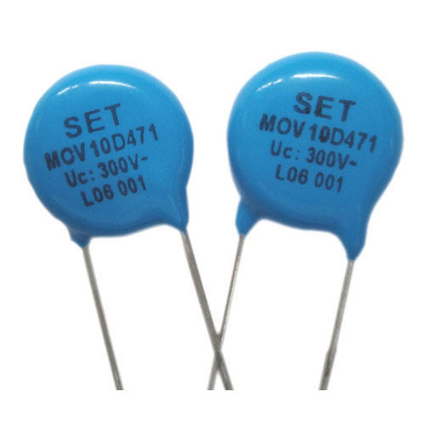
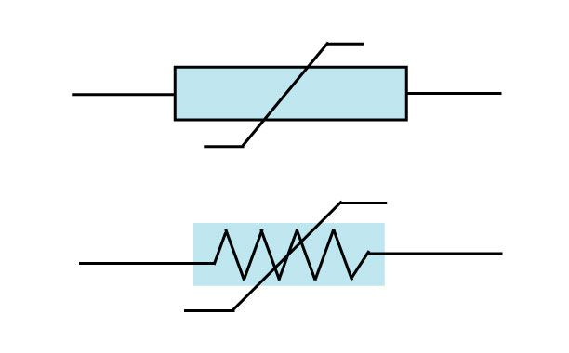
Varistors
A varistor is an electronic component whose resistance varies with the amount of voltage applied to it.
It is also called a voltage-dependent resistor.
At low voltage, the resistance of the varistor is usually high and decreases with increasing voltage.

Slide 47
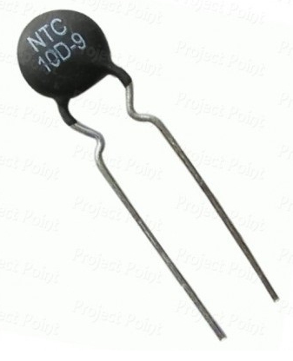
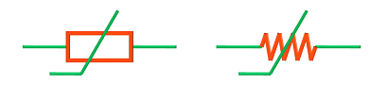
Thermistors
It is an electronic component whose resistance varies depending on the ambient temperature.
There are two types of thermistors: PTC, whose resistance increases with increasing ambient temperature, and NTC, whose resistance increases with decreasing ambient temperature.

Slide 48
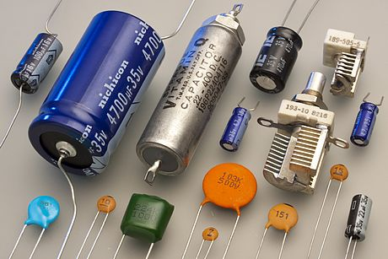
Capacitors and their types

Slide 49
What is a capacitor?
A capacitor is an element in an electrical circuit that can store electricity and supply it to the electrical circuit. It consists of two conductive electrodes of a certain shape with a layer of dielectric (rarely a semiconductor) between them. When a constant voltage is connected to the electrodes, they are charged, the dielectric polarizes and accumulates charges of the same size, but of the opposite sign - an electric field is created in the capacitor. The most important parameter of a capacitor is the electrical capacity. It is determined by the geometrical dimensions of the capacitor electrodes, the thickness of the layer of material between them and its dielectric constant

Slide 50
Capacitor specifications
The capacitor capacity is measured in Farads [F].
Capacity is denoted by the letter C. For example C = 100F.
Capacitors are adapted to work at certain voltages and some have polarity.
The capacity of the capacitor is calculated according to the formula :
$$C = \frac{Q}{U}$$
C- Capacity, Q- charge, U - voltage

Slide 51
Capacitor classification
Electrolytic capacitors.
Ceramic capacitors.
Adjustable capacitors.

Slide 52
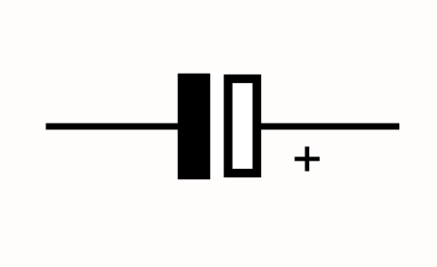
Electrolytic capacitors
Electrolytic capacitors have polarity, which means that one contact is connected to a positive voltage potential and the other to a negative one.
Electrolytic capacitors have a specified voltage that is the maximum it can support. Otherwise, it "burns" and is no longer usable.

Slide 53
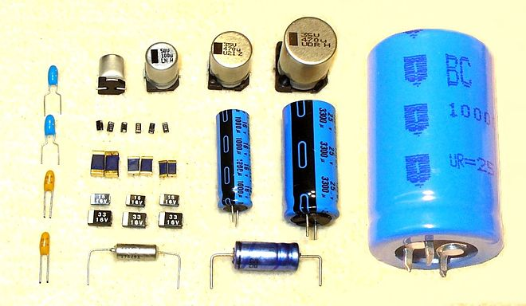
Electrolytic capacitors
They can store large amounts of energy and are commonly used to filter an electrical signal in both power supplies and amplifiers, or simply as a source of energy that can suddenly give it away, such as a camera flash.

Slide 54
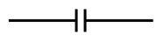
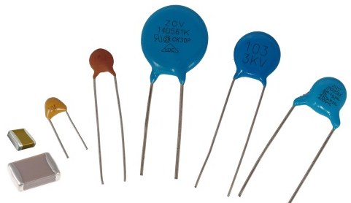
Ceramic capacitors
These capacitors have no polarity, so it does not matter which of the contacts will be connected to the positive voltage potential.
Because the dielectric is a ceramic layer, they are smaller than electrolytic capacitors and can take a variety of shapes.
Unlike electrolytic capacitors, which can have large capacities, ceramic capacitors are oriented to µF and smaller capacities.

Slide 55
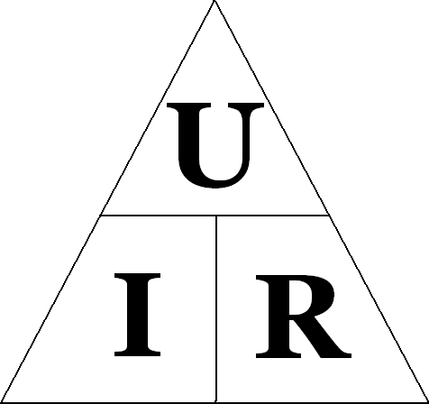
Ohm's law
A physical law that describes the relationship between voltage, current, and resistance in an electrical circuit. In other words, one of the most important formulas in electronics.
U – Voltage. Unit of measurement - Volts[V];
I – Current. Unit of measurement - Amperes[A];
R – Resistance. Unit of measurement - ohms[Ω]

Slide 56
Expressions of the law of ohm
Ohm's law relates voltage (V), current (I), and resistance (R) to each other.
It can be written in 3 ways, depending on what magnitude of current, voltage or resistance we want to calculate.
$I= \frac{V}{R}$; $V=I ×R;$ $R=\frac{V}{I};$

Slide 57
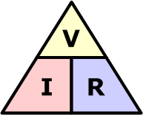
Ohm's law (triangle method)
If we want to find the voltage (V), cover V, you will see I and R, so V=I×R;
If we want to find the current (I), cover I, we will see V and R, so I=V/R;
If we want to find the resistance (R), cover R, we will see V and I, so R=V/I;

Slide 58
Use of Ohm's Law
Based on this law, voltage (V), current (I), resistance (R) can be calculated. Knowing the two parameters, one can easily calculate the third using the formulas mentioned above.
Suppose we want to connect a red light emitting diode (LED) to a 5 V line. The LED itself has its own specific voltage and current required for operation. The voltage required for the LED is 1.6 V and the current is 20 mA (20 mA = 0.02 A). According to the condition of the task, let's create a schematic diagram:

Slide 59
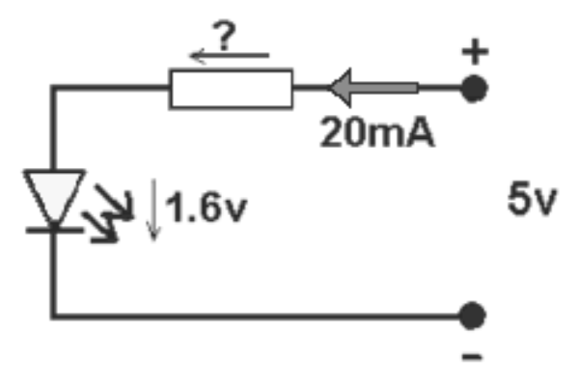
Use of Ohm's Law
So, we have a 5 V line, but the LED only needs 1.6 V, so the voltage needs to be reduced. This can be done using a properly sized resistor that will transform part of the voltage into heat.

Slide 60
Use of Ohm's Law
The LED must consume 1.6 V, in which case the voltage drop across the resistor must be 5 V - 1.6 V = 3.4 V. So we know the voltage (3.4 V) that the resistor has to convert to heat and the current of circuit (0.02 A).

Slide 61
Use of Ohm's Law
Next, applying one of the expressions R = V / I of the Ohm's law formulas, and setting the corresponding values, we obtain 3.4 V / 0.02 A = 170 Ω.

Slide 62
Use of Ohm's Law
However, often some of the calculated values do not have specific components, so you have to choose the closest value to the one that is produced. In our case, a suitable resistor of 180 can be obtained. When a 10 Ω larger resistor is connected, the LED will glow a little dimmer, as a current of less than 0.02 A will flow through it, but it is practically impossible to notice this.

Slide 63
Goodbye

Slide 65
Smart devices sensors programming
Asistentas : Simonas Česnauskas

Slide 66
Transistors and their types
A transistor is a semiconductor device commonly used to amplify electronic signals or as an electrically operated switch to direct signals. A transistor is a fundamental part of computers and other modern electronic devices. Invented back in 1948.

Slide 67
Transistors types
BJT
FET
NPN
PNP
JFET
MOSFET
N-channel
P-channel
N-channel
P-channel

Slide 68
BJT - Bipolar Junction Transistor
Has 3 terminals. Base (B), Emitter (E), Collector (C).
These are electricall curent operated components (I).
If a small current is applied to the component base (contact B), then the transistor can pass a significantly higher current traveling through the remaining contacts (through which, depending on whether it is PNP or NPN).
BJT transistors can operate in 3 operating modes, which will be reviewed below.

Slide 69
BJT transistor operating modes
Cut-off mode - in this mode the transistor is in the OFF state.
Active Mode - In this mode, the component acts as an amplifier.
Saturation mode - in this mode the transistor is as if it is in the full ON state.

Slide 70
BJT NPN transistors
This type of component consists of two N-type semiconductors separated by a thin layer of a P-type semiconductor.
In an NPN transistor, most of the charge carriers are electrons and a minority are holes. Electrons flowing from the emitter (E) to the collector (C) form a current flow at the base (B) contact of the transistor.
In a transistor, even a small current flowing at the base (B) can cause a large amount of current to flow from the emitter terminal to the collectors. Currently, the most commonly used BJTs are NPN transistors because of higher electron mobility compared to hole mobility..
When the transistor is in the OFF position, it conducts current.

Slide 71
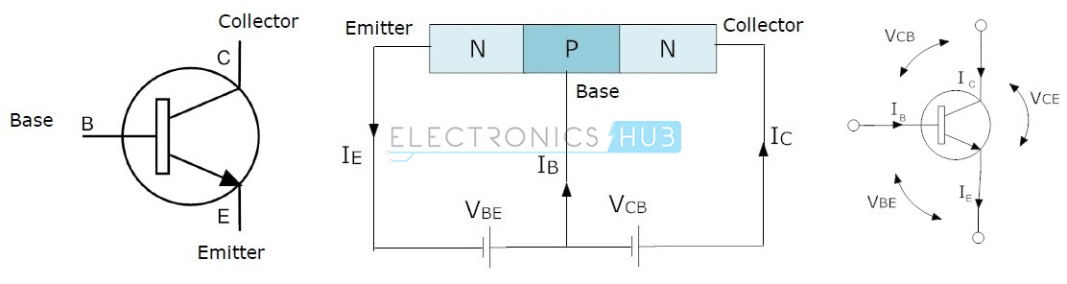
BJT NPN transistors

Slide 72
BJT PNP transistors
This type of component consists of two P-type semiconductors separated by a thin layer of N-type semiconductor.
In these transistors, most of the charge carriers are holes and a minority are electrons.
In this transistor, the arrow symbol in the diagram indicates the normal current flow. The direction of current flow in this transistor is from the emitter terminal to the collector terminal.
When the transistor is in the OFF state, it does not leak currents through itself.

Slide 73
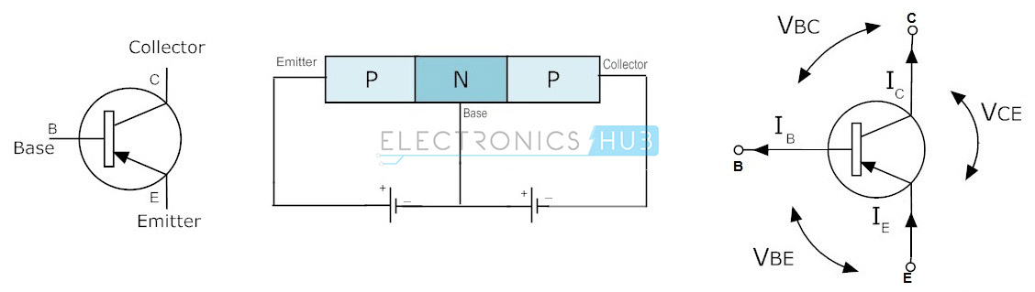
BJT PNP transistors

Slide 74
FET - Field Effect Transistor
The field effect transistor consists of 3 contacts, Gate (G), Source (S) and Drain (D). Unlike bipolar transistors, FETs are voltage controlled devices. The voltage connected to the Gate contact controls the current flow from the Source to the Drain contact of the transistor. Field effect transistors have very high input impedances, ranging from a few megaohms (MΩ) to much, much higher values..
Due to this high input resistance, very low currents flow through them. (According to the law of ohm, the current is inversely affected by the value of the circuit resistance. If the resistance is high, the current is very low.) Thus, both types of FET draw very little current from the circuit power supply.

Slide 75
FET - Field Effect Transistor
Thus, this is ideal because they do not interfere with the original circuit batteries to which they are connected. They do not overload the power supply. The disadvantage of FETs is that they do not provide the same amplification that could be obtained from bipolar transistors.
Bipolar transistors are similar at the time they are designed with higher gain, although on the other hand FETs are better at times when they are designed with lower load, and are easier to manufacture. There are two main types of field effect transistors: JFET and MOSFET. JFET and MOSFET are very similar, but the MOSFET input resistance values are even higher than JFET. This creates even less load on the circuit.

Slide 76
JFET – Junction Field Effect transistor
It is a voltage controlled device and does not use any current to connect it. When voltage is connected between the Gate and Source terminals, it controls the current flow between the Source and Drain contacts of the JFET transistor.
A JUGFET or JFET has no PN connectors, but is replaced by a narrow portion of a high-resistance semiconductor material that forms an N- or P-type silicon “channel” through which most carriers could flow with two electrical connectors at both ends, commonly referred to as the Drain and Gate.

Slide 77
JFET – Junction Field Effect transistor
There are two basic configurations of a junction field effect transistor: an N-channel JFET and a P-channel JFET. The N-channel JFET channel is supplemented with donor impurities, which means that the current flow through the channel is negative (which can also be understood from the name of the N-channel) in the form of electrons. These transistors are available in both P and N channel types.

Slide 78
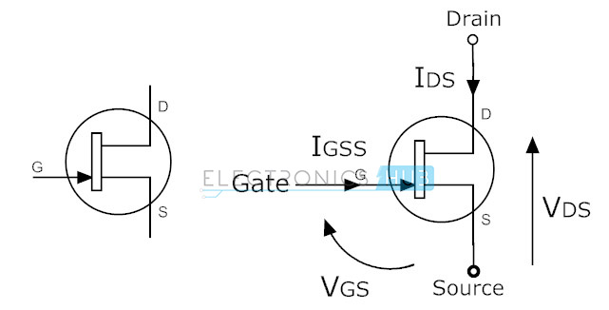
N-channel JFET

Slide 79
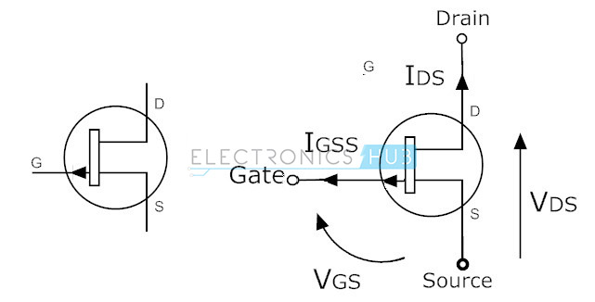
P-channel JFET

Slide 80
MOSFET – Metal Oxide Semiconductor Field Effect Transistor
This is the most commonly used type among all types of transistors. As the name suggests, it has a metal Drain clamp. This transistor has four terminals (contacts) such as Source, Drain, Gate and Substrate or Body.
MOSFETs are most commonly used in low power circuits, especially in the design of chips. These transistors are of two types, such as depletion and enhancement. In addition, these types are further subdivided into P and N channel types.

Slide 81
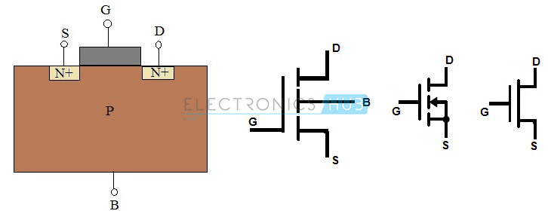
N-channel MOSFET

Slide 82
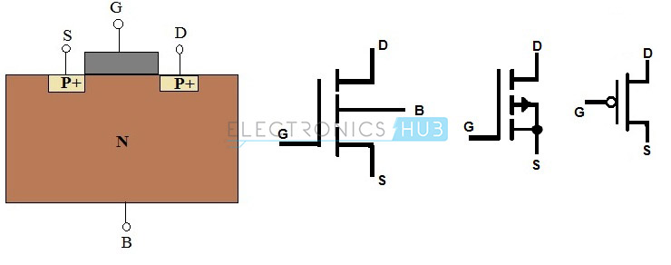
P-channel MOSFET

Slide 83
Diodes and their types
Diodes are electronic components that act as a non-return valve, meaning they allow current to flow in one direction. These diodes are made of semiconductor materials such as germanium, silicon and selenium. The operation of a diode can be classified in two ways, if it conducts current, then it is directed forward, otherwise it is inverted.
Different types of diodes have different voltage requirements. Silicon diodes require a voltage of 0.7v, and germanium - 0.3v. In a silicon diode, a dark band indicates the cathode terminal and the other terminal is the anode. Diodes are commonly used as reverse connection protection and short-term protection. There are many types of diodes, but the most relevant ones will be listed below.

Slide 84
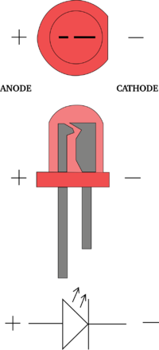
LED diodes
These diodes convert electricity into light energy. They undergo an electroluminescent process in which holes and electrons are recombined to produce energy in the form of light.

Slide 85

Zenre diodes
It is a passive element operating on the principle of zener decomposition. It is similar to a conventional diode that passes voltage directly through itself in one direction. However, the zener diode also conducts current in the reverse direction when the applied voltage reaches a critical point. It is designed to prevent voltage spikes that can severely damage other components. It acts as a voltage regulator.

Slide 86
Signal diodes
It is a small device with disproportionate characteristics and is most commonly used in high frequency and very low current devices such as radios or televisions. To protect the diode from contamination, it is enveloped in glass, which is why it is also called a glass passivated diode, which is widely used as 1N4148.
The appearance of the signal diode is very small compared to the power diode. To indicate the cathode terminal, one edge is marked in black or red. The signal diode is most efficient when working in high frequency circuits.

Slide 87

Signal diodes

Slide 88

Power diodes
These diodes have a large PN connector layer. Thus, the transformation of alternating current into direct voltage is common in their use. It also increases the power transmitted and the resistance to reverse transmission (puncture). Such signals will also interfere with the functional operating point. As a result, it is not suitable for use in high-frequency devices.

Slide 89


Coils and their types
A coil, a choke, or a reactor, is a passive electrical component of two terminals that, like a capacitor, stores energy in a magnetic field when an electric current flows through it. The coil usually consists of an insulated wire wound into a coil which has a core around which it is wound.

Slide 90
Air core coils
Ceramic core coils are also called "Air core coils". Ceramics is the most commonly used material for making coil cores. The coefficient of thermal expansion of ceramics is very low, so even at different operating temperatures, the inductance of the coil is stable. Because the ceramic does not have magnetic properties, the inductance of the coil does not increase due to the permeability of the core material.
The main purpose of this core is to give the shape of a coil. In some cases, the core will also provide a structure to hold the terminals. The main advantage of these inductors is very low core loss, high quality factor. They are mainly used in high frequency devices where low inductance values are required.

Slide 91


Air core coils

Slide 92

Iron core coils
In situations where small inductors are required, iron core inductors are the best choice. These inductors have high power and high inductance value, but are limited by high frequency capacities. Most are used in audio equipment. Compared to other inductors, their applicability is very limited.

Slide 93
Ferrite core coils
There are mainly two types of ferrite cores, these are soft and hard ferrite cores. Ferrite is classified according to the ability of a magnetic field to demagnetize it from a state of full saturation to zero.

Slide 94
Soft ferrite
These materials can change their magnetization polarity without any particular amount of energy required to change the magnetic polarity.

Slide 95

Hard ferrite
They are also called permanent magnets. Consequently, they will retain the polarity of the magnetization even after removing the magnetic field.
The ferrite core inductor will help to improve the performance of the inductor (coil) by increasing the throughput of the coil, which increases the value of the inductance. The level of permeability of the ferrite core used in the coils will depend on the ferrite material. Depending on the ferrite material, this level of permeability ranges from 20 to 15,000. Thus, the inductance is very high in a ferrite core compared to an inductor with an air core.

Slide 96
Toroids
The wire is wound on a core whose surface is in the shape of a ring or a donut. Typically, the core consists of different materials such as ferrite, iron powder, and the like. This inductor has high efficiency due to its round shape and fast saturation.
Its layout provides minimal magnetic field loss, which helps prevent the magnetic field from intersecting with other devices. It is characterized by high energy transmission efficiency and high inductance values when applied in low frequency circuits. These inductors are mainly used in medical devices, switching regulators, air conditioners, refrigerators, telecommunication and musical instruments, etc.

Slide 97

Toroids

Slide 98


Power supplies
A power source is an electrical device that supplies electricity to an electrical load. The main function of a power supply is to convert electricity from the source into a signal with the proper voltage, current, and frequency to power the load. Therefore, power supplies are sometimes referred to as power converters. Some power supplies are separate, separate pieces of equipment, while others are built into the devices they power.

Slide 99

Alternating current (AC)
Alternating current (AC) is an exceptional case of regularly alternating current. The current voltage passes through zero, alternately, reaching positive and negative values, determined in a repeatable manner. One complete cycle of value changes is called a period, so that type of current is also called periodic. Its graph is presented in the form of a sinusoid.

Slide 100

Kintamoji elektros srovė (AC)
The main parameters describing the alternating current are period, frequency (expressed in Hertz) and amplitude. AC is being used on power lines around the world. For powering all devices marked with the AC symbol and the sinusoidal symbol. Although voltage and frequency values may vary from country to country (e.g., USA is 110 V at 60 Hz).

Slide 101

Direct current (DC)
Direct current (DC), unlike alternating current, has two poles - negative and positive. There is a potential difference between them, that is, tension. By convention, both electricity loads move from the positive pole to the negative pole, although in reality the opposite is true. The DC diagram is a straight line.

Slide 102

Direct current (DC)
The main direct current source is power supplies and galvanic cells (i.e., batteries and accumulators). Most electronic devices are specifically powered by direct current. It can be obtained without any problems through power supplies and rectifiers, directly from an AC outlet that carries AC power.

Slide 103
Electronic circuits
Electronics are distinguished by many types and specification schemes. However, the meaning of all of them remains similar - to explain the operation, structure, logic and the like of the device. The following are an overview of several types of schemes you may encounter.

Slide 104

Electrical schematics
Wiring diagrams do not reflect the actual arrangement of components in the device, but usually have a certain arrangement of components.
They specify which contacts of the component used are connected to the next component and which are connected to the power supply.
Thus, electrical schematics indicate the paths of electricity flow.

Slide 105

Electrical schematics

Slide 106

Wiring diagrams
Wiring diagrams are usually used when the device consists of separate modules that have certain contacts that must be connected to both the power supply and each other.
So wiring diagrams specify exactly which contacts are connected, where and to whom.

Slide 107

Wiring diagrams

Slide 108
Structure diagrams
Layout diagrams are usually the initial stage in the design of a device because in them polarity, and terminal connection does not mater.
The essence of the structure diagram is the connection logic, in order to graphically represent which block is connected to what.

Slide 109

Structure diagrams

Slide 110
The devices that are used in electronics
Below we will review the basic devices, the tools that are most commonly used in electronics.

Slide 111

Multimeter
A multimeter, or multitester, is an electronic measuring device that combines several measuring functions in one device. A typical multimeter can measure voltage, current, resistance, capacitance and sometimes inductance.

Slide 112

Oscilloscope
An oscilloscope, is a type of electronic device that graphically displays a variable signal voltage, usually as a calibrated, 2D diagram of one or more signals as a function of time. The waveform shown can then be analyzed for properties such as amplitude, frequency, rise time, time interval, distortions, and so on.

Slide 113

Oscilloscope

Slide 114

Soldering iron and its accessories
This device comes in many shapes and variations, but basically it is just a device with a certain resistance, the front of which heats up to a high temperature (0-500 degrees).
Using a hot part of the device, the contacts for soldering the component are heated and the required solder layer is melted on them (with the help of a soldering iron), which, when the soldering iron is removed, suddenly cools and hardens, thus forming a strong electrical contact.

Slide 115

Soldering iron and its accessories

Slide 116


Precision screwdrivers
Because in many cases, when trying to repair, improve, or just see real diagrams, the device needs to be disassembled, its housing opened, so precision screwdrivers are an integral part of electronics.
Especially in these times, when there are an infinite number of different types of screws and many of them are designed specifically for protection against opening, so special screwdrivers of unusual shape are necessary.

Slide 117

Precision screwdrivers

Slide 118
Goodbye

Slide 120
Programming of smart device components
Asistentas : Simonas Česnauskas

Slide 121
Connection of the resistors
In electronics, there are two ways in which components can be connected, that is, in parallel or in series. A third, mixed combination of components can also be distinguished. When in a circuit the components are connected both in parallel and in series.
Depending on the way the resistors are connected, the final resistance and capacity of the circuit vary.

Slide 122


Resistors in series
Connecting resistors in series means that all resistors are connected in a straight circuit one after the other.
Since they are connected one after the other, the current entering the first resistor of the circuit has no choice but to flow further to the second, then the third, and so on.
This means that the same current flows through the entire resistor circuit.

Slide 123

Resistors in series
A series of resistors connected in series can be thought of as a single resistor with a resistance equal to the sum of the resistances of all the resistors in the circuit.

Slide 124
Resistors in series
The total voltage traveling through such a resistor circuit will be equal to the sum of the voltage crossings on the resistors R1 R2 and R3.
$V_{AB}=V_{R1}+ V_{R2}+ V_{R3} =9_{V}$
The voltage drop across the resistors can be calculated using the law of ohm.
Voltage drop across $R_{1},U=I×R_{1} =0,001\left[A\right]×1000\left[Ω\right]=1V$
Voltage drop across $R_{2},U=I×R_{2} =0,001\left[A\right]×2000\left[Ω\right]=2V$
Voltage drop across $R_{3}, U=I×R_{3} =0,001\left[A\right]×6000\left[Ω\right]=6V$

Slide 125
Resistors in series
That imaginary resistor whose resistance corresponds to the sum of the resistances of all series-connected resistors in the circuit is also called the equivalent resistance, or $R_{EQ}$.
$R_{EQ}$ it is a resistor that can be placed in the circuit instead of the desired series of resistors connected in series and would not change the overall voltage or current of the circuit.

Slide 126
Resistance formula for resistors connected in series
$$R_{EQ}= R_{1}+ R_{2}+ R_{3}+ <…> + R_{n}$$

Slide 127
Voltage formula for resistors connected in series
$$V_{source} = V_{R1}+ V_{R2}+ V_{R3}+ <…> + V_{Rn}$$

Slide 128

Resistors in series example
Using the formulas above and the laws of omo, calculate the circuits:
Total resistance.
Current flowing in the circuit.
Voltage drop on the resistor.
Total circuit power.

Slide 129
Nuoseklaus jungimo pavyzdys
$R_{Total}=10+20+30 =60Ω$
$I_{Total} = \frac{V}{R} = \frac{12}{60} =0,2A =200mA$
$V_{1} =I ×R =0,2 ×10\left(R1\right)=2V$
$P_{Total} =V ×I =12 ×0,2 =2,4W$

Slide 130
Parallel connection of the resistors
Resistors are connected in parallel when the contacts of all resistors used are connected to two points.
The circuit of the components connected in parallel will have a constant voltage. However, there is more than one path where current can flow, so circuit will have alternating current.

Slide 131

Parallel connection of the resistors
To find the equivalent (total) resistance of a circuit of resistors connected in parallel, we use the following formula :
$\frac{1}{R_{total}} = \frac{1}{R_{1}}+ \frac{1}{R_{2}}+ \frac{1}{R_{3}}+ <…> + \frac{1}{R_{n}}$

Slide 132
Parallel connection of the resistors
If the resistances of the resistors connected in parallel are the same, then the formula can be used :
$$R_{total}= \frac{R}{N}$$
Where:
R – resistance.
N – number of the resistors connected.

Slide 133
Parallel connection of the resistors
If only two resistors are connected in parallel, whether or not their resistances are the same, the following formula can be used :
$$R_{total} = \frac{R_{1}×R_{2}}{R_{1}+R_{2}}$$

Slide 134

Example of parallel resistors connection

Slide 135

Example of parallel resistors connection
Find the total resistance of the diagram below.

Slide 136
Example of parallel resistors connection
$\frac{1}{R_{total}}=\frac{1}{R_{1}}+ \frac{1}{R_{2}}+ \frac{1}{R_{3}} = \frac{1}{200}+ \frac{1}{470}+ \frac{1}{220} ≈0,0117$
$R_{total} = \frac{1}{0,0117}=85,67Ω$

Slide 137

Example of parallel resistors connection
Calculate the total resistance of the given circuit.

Slide 138
Example of parallel resistors connection
$R_{total}=\frac{22000×47000}{22000+47000}=14,985 ≈15kΩ$

Slide 139
Parallel connection of the resistors
Since resistors connected in parallel may have different resistance values, according to the law of ohm, the currents flowing through them will also be different.
They can be calculated using the law of ohm.
The total circuit current can be found either by summing the currents flowing with the resistors, or by having the total circuit voltage and the total resistance, the current can be then calculated according to the ohms law.

Slide 140



Parallel connection of the resistors

Slide 141
Mixed connection
This happens when both series and parallel connections are used in the circuit.
Such circuits can be quite difficult to deal with.

Slide 142

Mixed connection
You need to find the total current that this circuit consumes from a 12 volt power supply.

Slide 143
Mixed connection
Looking more closely, we see that R2 and R3 are connected in series, so we calculate their total resistance and replace them in the diagram with one resistor whose resistance will be equal to the sum of R2 and R3.
$R_{A}=R_{1}+R_{2}=4+8 =12Ω$

Slide 144

Mixed connection
We can now see that the resistance we create is connected in parallel with the R4 resistor. Thus, based on the resistors connected in parallel, we calculate the total resistance of their resistance calculation formula.
$\frac{1}{R_{R_{a},R_{4}}}=\frac{1}{R_{A}}+\frac{1}{R_{4}}=\frac{1}{12}+\frac{1}{12}=0,1667$
$R_{R_{a},R_{4}}=\frac{1}{0,1667}=6Ω$

Slide 145

Mixed connection
So we now have a simple circuit of two resistors connected in series, the resistance of which we calculate accordingly according to the series connection formula.
$R_{total}=R_{1}+R_{comb}=6+6=12Ω$

Slide 146

Mixed connection
So now we simply calculate the current on one resistor.
$I=\frac{V}{R}= \frac{12}{12}=1A$

Slide 147
What is a voltage divider?
Voltage divider is a series circuit of connected resistors with different voltage drops on each resistor.
As mentioned in previous lectures, this is essentially a potentiometer, simply assembled from several individual components.

Slide 148

What is a voltage divider?
In the typical voltage divider circuit shown, we can see that the output voltage is taken from the resistor R2 and the power supply.
The output voltage is calculated according to the formula below.
$V_{out}=V_{in}\left(\frac{R_{2}}{R_{1}+R_{2}}\right)$

Slide 149

What is a voltage divider?
As we can see from the given example, when another resistor is connected to the voltage divider circuit as a load, the voltage drop decreases.
The higher the load resistance we connect, the more the voltage drop will decrease.

Slide 150
What is a voltage divider?
Voltage dividers are used in many places, but the most obvious example is sensors.
For example, the simplest light level sensor can be made using a voltage divider circuit in which a photoresistor is connected instead of a load resistor, the resistance of which varies depending on how much light falls on it.

Slide 151
Goodbye

Slide 153
Programming of smart device components
Asistentas : Simonas Česnauskas

Slide 154
Connecting to terminal servers without vpn

Slide 155

Connecting to terminal servers
We find and launch „Remote desktop connection“.

Slide 156

Connecting to terminal servers
Enter the name (address) of the server / computer you want to connect to.
Names of EIF terminal servers :
wts1.ad.viko.lt
wts2.ad.viko.lt

Slide 157

Connecting to terminal servers
We enter our login details.

Slide 158

Multisim

Slide 159

Multisim
We find multisim 14.1 using search.

Slide 160

Multisim
Then we see the main window of the multisim program.

Slide 161
Main window layout
Here you will find the files you are currently working on, the files associated with it also. You can also find some settings related to the project here.

Slide 162
Main window layout
Toolbar. It contains the main necessary components, measuring devices and power supplies. Also settings related to simulation.

Slide 163
Main window layout
The remaining measuring devices, functional generators, etc.

Slide 164
Main window layout
The system status window contains the results of simulations, etc.

Slide 165
Main window layout
Simulation options

Slide 166

Component Library
We choose PLACE -> COMPONENT...
Or press CTR+W

Slide 167

Component Library

Slide 168

Component Library
Component groups by purpose

Slide 169

Component Library
List of subgroups

Slide 170

Component Library
Specific components
which we need to choose

Slide 171

Component Library
By double-clicking on the placed component, we can modify its parameters. In this case, since we have a DC power supply, the most important thing for us to change is its voltage.

Slide 172

Measuring instruments
To measure the basic parameters of the circuit, we choose the Multimeter measuring device. Which we can use to measure voltage, current and resistance, both AC and DC.

Slide 173

Measuring instruments
The voltmeter is connected to the circuit in parallel.

Slide 174

Measuring instruments
The ammeter is connected to the circuit in series.

Slide 175

Scheme assembly
Let's assemble the simplest circuit with a resistor and a red LED. We first compile the components from the library in the main window.

Slide 176

Scheme assembly
Because the value of the resistor depends on the supply voltage and the voltage required for the LED. We choose that our supply voltage will be 5V. And we change it in the program by double-clicking on the component.

Slide 177

Scheme assembly
What voltage is required for the LED we can see when we select it from the component library.

Slide 178
Scheme assembly
Once we know these values according to the law of ohm, we can calculate what value the resistor will be used.
5 – 1.83 = 3.17V.
R = V / I; R = 3.17V / 0.005A = 634 ohms.

Slide 179

Scheme assembly
Then by double-clicking on the resistor in the multisim program, we can change its value to the required one.

Slide 180

Scheme assembly
After all the changes, we finally have a schematic with the required components.
To connect them, click on the component contact and then click on where we want to connect it.
The positive contact of the power supply is the one with the longer line.

Slide 181
Measurements
Voltage drop on the resistor.
Voltage drop on the LED.
Power supply voltage check.
Resistor resistance measurement.
Circuit current consumption measurement.

Slide 182

Voltage drop on the resistor

Slide 183

Voltage drop on the LED

Slide 184

Power supply voltage check

Slide 185

Resistor resistance measurement

Slide 186

Circuit current consumption measurement

Slide 187
Goodbye

